Slide 1
Creating HTML elements dynamically in web pages
TEAM MEMBERS:
HEMANTH KUMAR V - 23MX110
VARADHARAJAPERUMAL T - 23MX128
HARI KISHORE G - 23MX207
MAHALAKSHMI R - 23MX214
MERLIN YAZHINI A T - 23MX216

Slide 2
AGENDA
What is DHTML?
Components of DHTML
Benefits of DHTML elements
Static vs Dynamic web pages
Different ways to get HTML elements
Types of function used
Variables in JS
Elements used
Demo
Summary

Slide 3
What is DHTML?
DHTML stands for Dynamic Hypertext Markup language i.e., Dynamic HTML.
Dynamic HTML is not a markup or programming language but it is a term that combines the features of various web development technologies for creating the web pages dynamic and interactive.
The DHTML application was introduced by Microsoft with the release of the 4th version of IE (Internet Explorer) in 1997.
Dynamically generating HTML code or content.
DHTML - Content can be generated dynamically both at the back end (server side) or at the front end.

Slide 4
Components of DHTML
HTML 5.0
CSS
JavaScript
DOM

Slide 5
Benefits of Dynamic HTML
Create - interactive and responsive web pages
Update content of page without full page reload
Improved user interface
Create Dynamic menus
Tool tips and other User Interface elements that respond to user actions – more intuitive and user friendly
Facilitates Asynchronous Communication with server
Enables data to be retrieved from server in the background
No need to refresh entire page
Leads to faster and more efficient UI
Technologies used – XMLHttpRequest, FetchAPI
Enhanced Animation and Visual Effects
Using JSS and CSS in tandem – can create Transitions and visually appealing content

Slide 6
Benefits of Dynamic HTML (cont.)
Form validation and feedback
Validate form data on client side before sending to server
Instant feed back to user - better user experience
Reduces number of http requests to server
Responsive web design
Dynamically adjusting layout and sizing of elements based on users device specs
Facilitates same level of user experience across devices
Real time updates
DHTML supports real time updates
Useful for applications that require live updates
Chat applications
Live feeds, Live Scores
Collaborative editing tools

Slide 7
Benefits of Dynamic HTML (cont.)
Interactive Widgets
User Interface elements on a web page that helps user interact and manipulate contents
Sliders, Progress bars
Volume controls, Interactive maps etc.
Reduced server load
Updating only the necessary parts of page and not entire page
Cross-Browser compatibility
Modern DHTML techniques are designed to work across different web browsers
Facilitates consistent user experience irrespective of the browser used
Enhanced user experience
Smooth and enjoyable user experience helps retain users - user will visit the web site more often

Slide 8
Static VS Dynamic Webpage
Aspect | Static Webpage | Dynamic Webpage
Content | Fixed and unchanging content. | Content can change based on user input, interactions, or real-time events.
Technology | Typically built with HTML and CSS. | Requires HTML, CSS, JavaScript, and server-side technologies.
Data Handling | Content is hard-coded into HTML files. | Can fetch data from databases and external sources.
Performance | Generally faster loading times. | May have longer loading times due to server-side processing.
Maintenance | Manual updates to HTML and CSS files. | Content can be updated more easily through content management systems (CMS).
Scalability | Less suitable for websites with extensive content or complex interactivity. | Suitable for websites with extensive content and interactivity.
User Interaction | Limited interactivity, mostly static. | Supports user interactions, form submissions, and real-time updates.
Real-Time Data | Does not display real-time data. | Can display real-time data, such as live notifications or updates.

Slide 9
<!DOCTYPE html>
<html lang="en">
<head>
<meta charset="UTF-8">
<meta name="viewport" content="width=device-width, initial-scale=1.0">
<title>Dynamic webpage</title>
<link rel="stylesheet" href="style.css">
</head>
<body>
<div class="header" id="title_header">
<span id="dateTime"></span>
<h1>Dynamic webpage</h1>
</div>
<div class="side-nav"> <br><br><br><br><br><br>
<button id="HeaderButton" onclick='changeheader();'><b>Header</b></button>
<button id="animation"><b>Animation</b></button>
<button id="graphicsButton"><b>Graphics</b></button>
<button id="pTagButton"><b>Paragraph Tag</b></button>
<button id="attributesButton"><b>Attributes</b></button>
<button id="Tablebutton" onclick="createTable();"><b>Create table</b></button>
<button id="footerButton"><b>Footer</b></button>
</div>
<div class="content" id="content"></div>
<div class="output-but"> <button id="reset"><b>Reset</b></button>
</div>
<div>
<footer class="last_one" id="last_one">Done by :<br>Hemanth&nbsp;&nbsp;Varadharajaperumal&nbsp;&nbsp; Hari Kishore &nbsp;&nbsp;Mahalakshmi &nbsp;&nbsp; Merlin </footer>
</div>
<script src="script.js"></script>
</body>
</html>

Slide 10
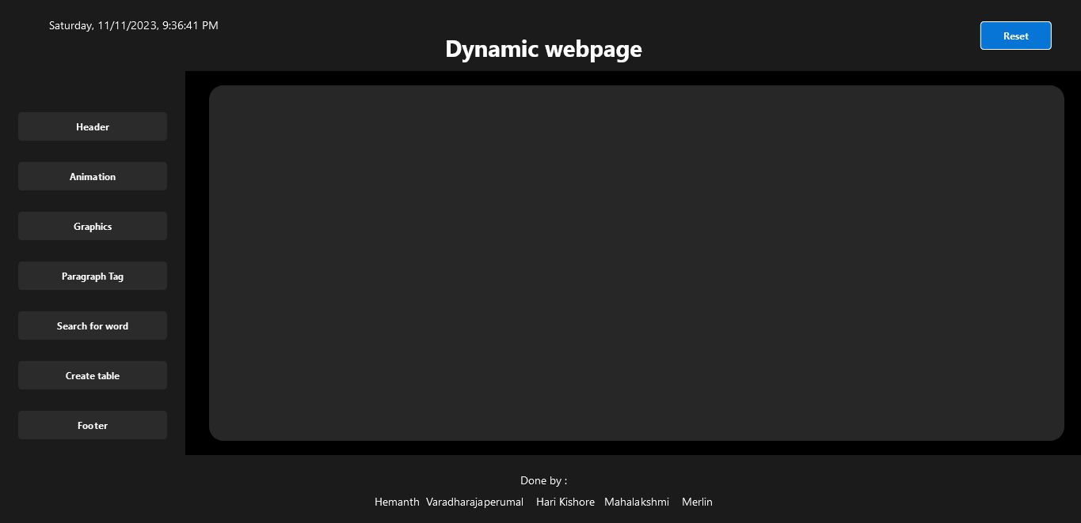

Slide 11
Different ways to get HTML elements
By Id
By Class
Using QuerySelector
Using QuerySelectorAll
Using Tags
Example:
const content = document.getElementById("content"); //getting element by id
const footerButton = document.getElementsByClassName("last_one"); //getting element by
classname
const graphicsButton = document.querySelector("#graphicsButton"); //getting element by
querySelector

Slide 12
Types of function(the ones that we used)
Functions
Arrow functions
Example:
Function example:
function clearEffects() {
content.style.animation = "none";
content.style.backgroundColor = "initial";
content.style.color = "initial";
content.style.fontFamily = "initial";
}
Arrow Function example:
animation.addEventListener("click", () => {
clearEffects();
content.innerHTML = "<div class='but-animation'><center ><h1 class='header-text'>Dynamic Web Page</h1><p class='header-para'>Web Technology Presentation</p></center></div>";
content.style.backgroundColor = "white";
});

Slide 13
Variables in JS
Variables are Containers for Storing Data
JavaScript Variables can be declared in 4 ways:
Automatically
Using var
Using let
Using const
When to Use var, let, or const?
var:
Function Scope: Variables declared with var are function-scoped, meaning they are only visible within the function in which they are declared.
Hoisting: Variables declared with var are hoisted to the top of their scope, allowing them to be used before the declaration in the code.
let:
Block Scope: Variables declared with let are block-scoped, meaning they are only visible within the block (statement or expression) where they are defined.
No Re-declaration: Unlike var, you cannot re-declare a variable with let in the same scope.
const:
Block Scope: Like let, variables declared with const are block-scoped.
Immutable Value: Variables declared with const cannot be reassigned once a value is assigned.

Slide 14
Header
<div class="header" id="title_header">
<span id="dateTime"></span>
<h1>Dynamic webpage</h1>
</div>
changeheader=function(){
clearEffects();
let titleheader= document.getElementById("title_header");
titleheader.style.color="orange";
titleheader.style.fontFamily="Lucida Console", "Courier New";
titleheader.style.fontSize="30px";
titleheader.style.height="fit-content";
titleheader.style.backgroundColor="lightblue";
}

Slide 15
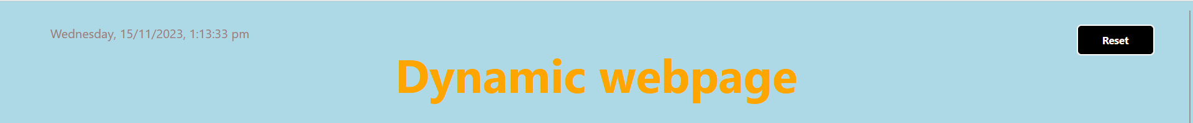
function updateDateTime() {
const dateTimeElement = document.getElementById("dateTime");
const currentDate = new Date();
const formattedDateTime = currentDate.toLocaleString('en-IN', {
weekday: 'long',
year: 'numeric',
month: 'numeric',
day: 'numeric',
hour: 'numeric',
minute: 'numeric',
second: 'numeric',
hour12: true
});
dateTimeElement.textContent = formattedDateTime;
}
updateDateTime();
setInterval(updateDateTime, 1000);

Slide 16
Paragraph Tag
pTagButton.addEventListener("click", () => {
clearEffects();
content.innerHTML = "<div class='ptag'><center><p>About<b><br> <br> <hr> <br>Creating a web page using dynamic HTML elements allows you to build web content that can change and adapt based on user interactions, input, or data.<br> Dynamic web pages are commonly created using a combination of HTML, CSS, and JavaScript.</b></p></center></div>";
content.style.backgroundColor = "lightyellow";
});
function clearEffects() {
content.style.animation = "none";
content.style.backgroundColor = "rgb(39, 39, 39)";
content.style.color = "initial";
content.style.fontFamily = "initial";
}

Slide 17
.ptag{
transform: translateY(200px);
animation: wordgap 3s ease-in;
}
@keyframes wordgap {
0% {
word-spacing: 320px;
line-height: 340px;
opacity: 0;
}
100% {
opacity: 1;
word-spacing: 0px;
}
}

Slide 18
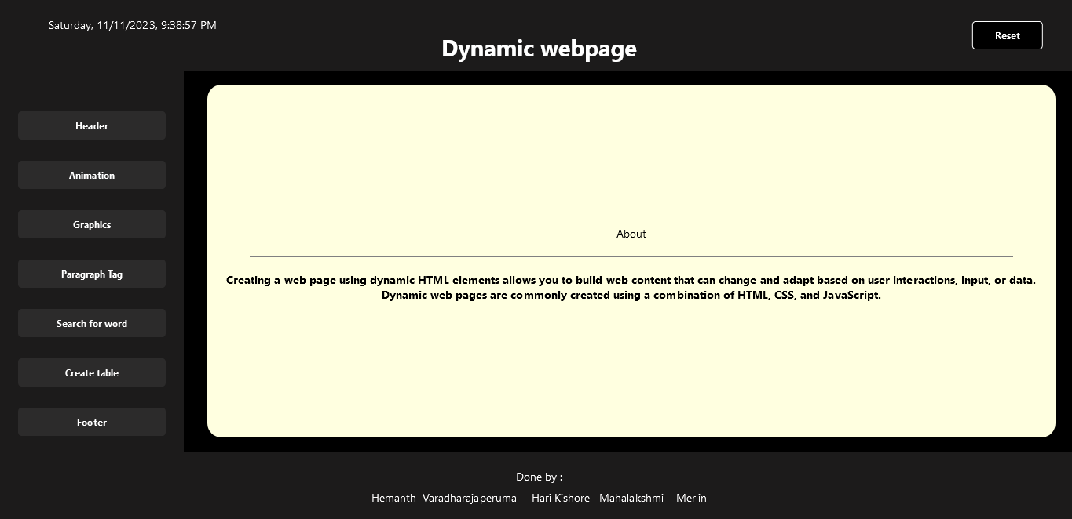

Slide 19
Search for a word - Using Regular Expression
attributesButton.addEventListener("click", () => {
clearEffects();
const userInput = prompt("Enter the text:");
if (userInput) {
const regex = new RegExp(userInput, 'ig');
const contentText = content.innerHTML;
if (regex.test(contentText)) {
content.innerHTML = contentText.replace(regex, (match) => {
return `<span style="background-color:blue;">${match}</span>`;
});
content.style.color="lightgrey";
content.style.backgroundColor = "brown";
}
else {
alert("User input does not match any content in the 'content' area.");
}
}
else {
alert("No input provided");
}
});

Slide 20
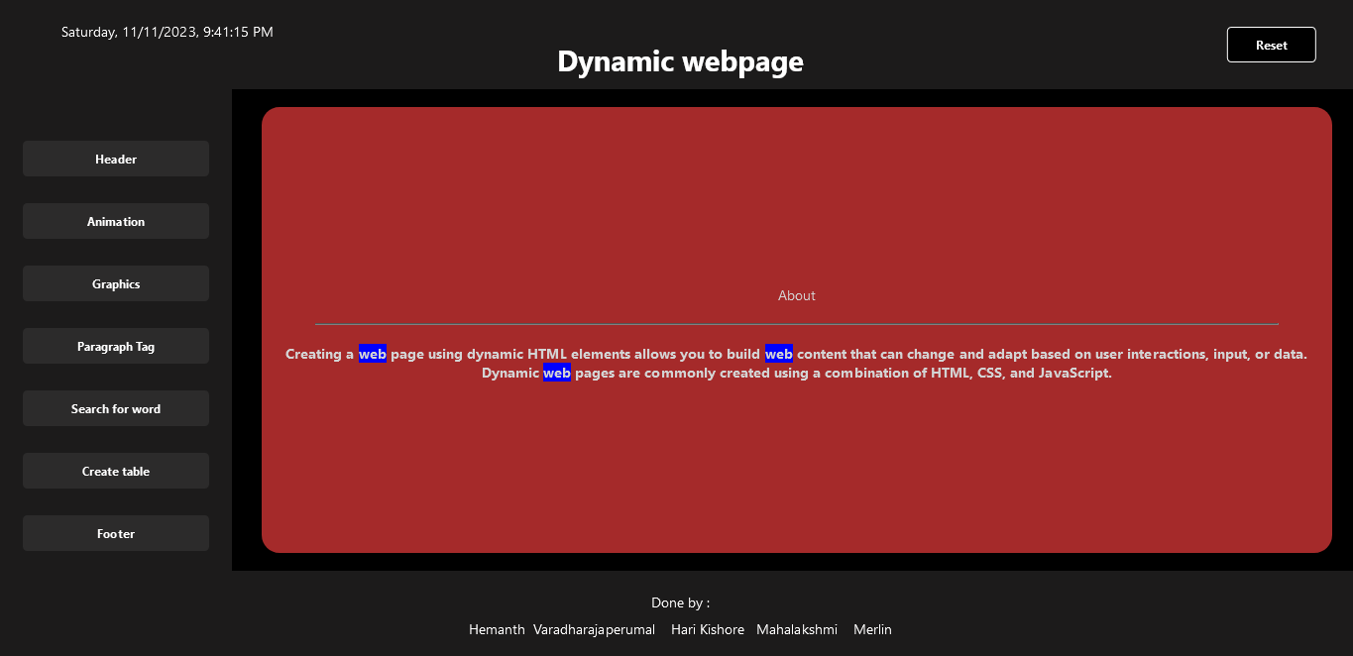

Slide 21
Create Table dynamically
createTable = function () {
clearEffects();
content.style.backgroundColor = "white";
let mRows = prompt("Enter number of rows (greater than 1) : ");
let nCols = prompt("Enter number of columns (greater than 1) : ");
if (mRows > 1 && nCols >= 1) {
content.innerHTML = "<table id='mytable' class='but-table'></table>"
tbl = document.querySelector("#mytable")
for (i = 0; i < mRows; i++) {
row = document.createElement("tr");
row.style.border = '4px solid red';
if (i === 0) {
cell = document.createElement("th");
cell.innerText = prompt("Enter table title : ");
cell.style.width='220px';
cell.style.colspan = 8;
cell.style = 'text-align : center';
cell.style.height = '35px';
cell.style="text-align: center";
row.appendChild(cell);
}

Slide 22
else {
for (j = 0; j < nCols; j++) {
cell = document.createElement("td")
let x = Math.random() * 100;
x = Math.round(x);
cell.innerText = x;
cell.style = "text-align: center";
cell.style.width = '100px';
cell.style.height = '35px';
cell.style.backgroundColor = 'rgb(82, 196, 196)';
row.appendChild(cell);
}
}
tbl.appendChild(row);
}
tbl.style.backgroundColor = "lightblue";
tbl.style.border = '4px solid red';
}
else {
alert('Please enter valid values for rows and columns');
}
}

Slide 23
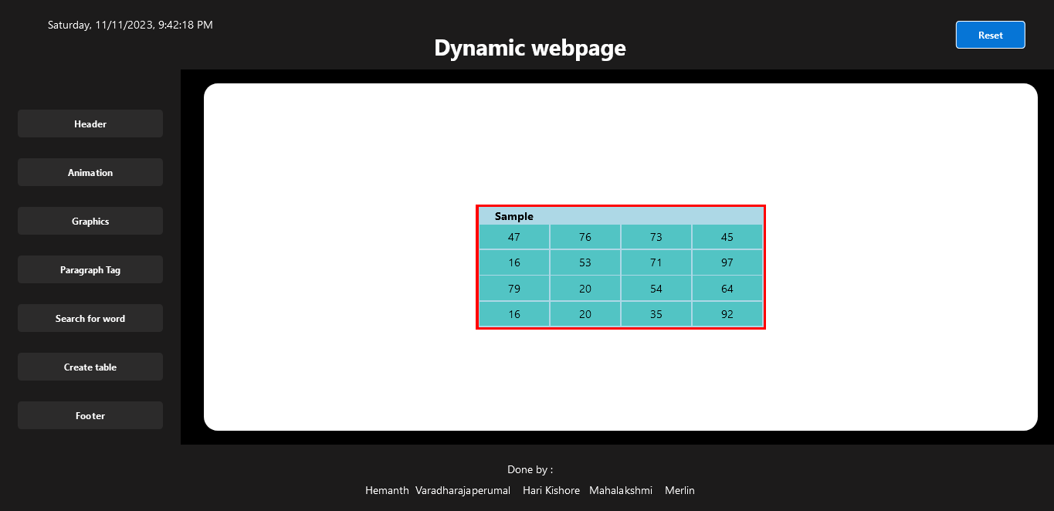

Slide 24
Animation
animation.addEventListener("click", () => {
clearEffects();
content.innerHTML = "<div class='but-animation'><center ><h1 class='header-text'> Dynamic Web Page</h1><p class='header-para'>Web Technology Presentation</p></center></div>";
content.style.backgroundColor = "white";
});
.but-animation{
transform: translateY(200px);
}
@keyframes fadeIn {
0% {
opacity: 0;
transform: translateY(0px);
}
50% {
opacity: 0.7;
}
100% {
opacity: 1;
transform: translateY(150px);
}
}

Slide 25
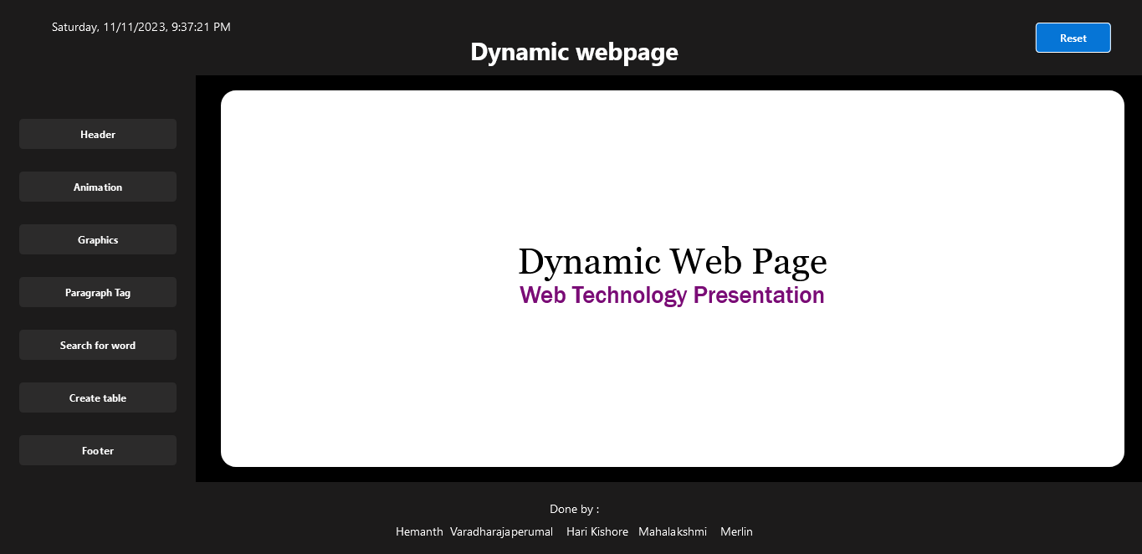

Slide 26
Graphics
graphicsButton.addEventListener("click", () => {
clearEffects();
content.innerHTML = "<div class='graph-img'><img src='./image/background.jpg' alt='Web Design' width='100%'></div>";
});
.graph-img img{
width: 1200px;
height: 530px;
animation: zoomIn 4.5s;
}
@keyframes zoomIn {
0% {
transform: skewY(100deg);
}
100% {
transform: skewY(0deg);
}
}

Slide 27
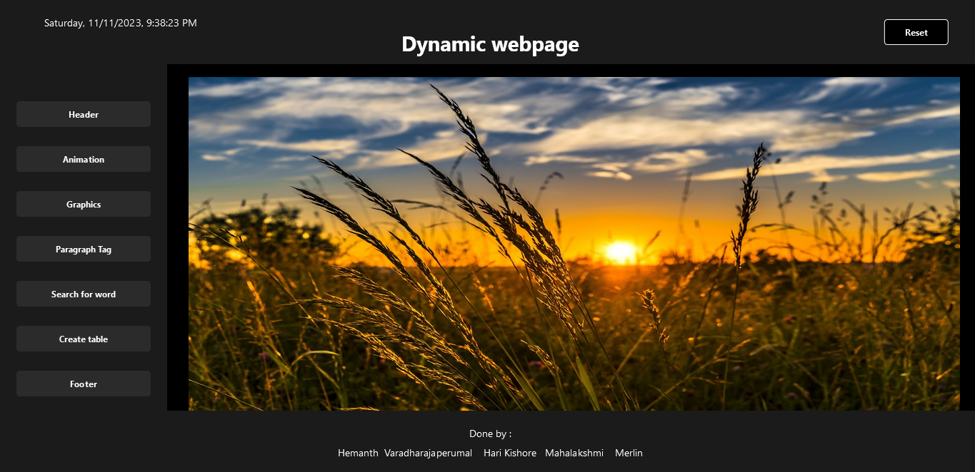

Slide 28
Footer
footerButton.addEventListener("click", () => {
last_one.classList.add("testing");//here calling the css properties by classname
last_one.innerHTML = " <h1> THANK YOU &#128591; </h1>"
});
.testing{
position: absolute;
bottom: 0px;
width: 100%;
background: linear-gradient(to right, #feda75,#fa7e1e,#d62976,#962fbf,#4f5bd5);
}

Slide 29
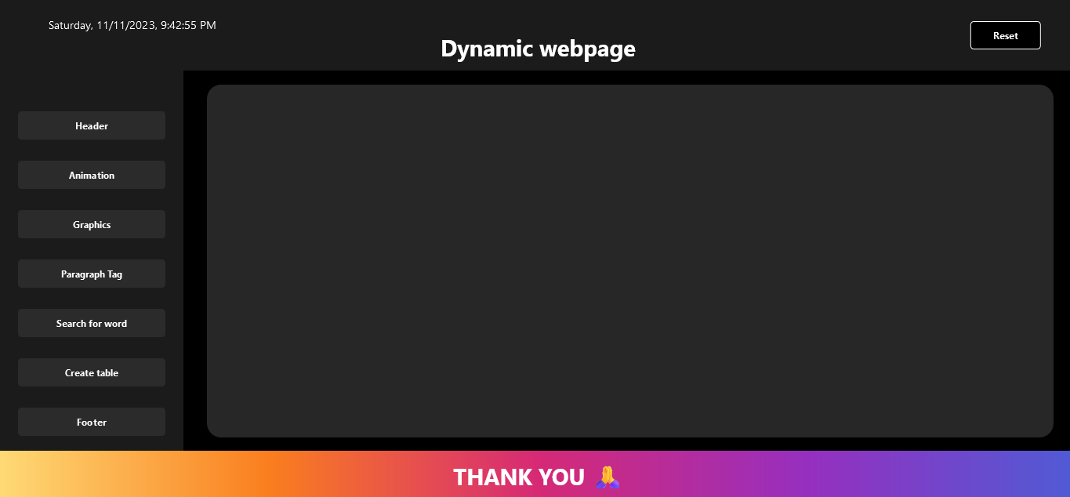

Slide 30
Summary
HTML TAGS : Fundamental Building Blocks used to structure and present content on the web
page.
<div> Used to group and style content in various sections.
<center> Used for centering content horizontally.
<h1> Define headings.
<p> Define a paragraph of text.
<b> Make the text bold.
<hr> Create a horizontal line.
<img> Used for displaying images.
<span> Inline container used to apply styles to a specific part of text.
<table> Defines an HTML table.
<tr> Define a row of cells.
<th> Define the content inside; typically bold and centered.
<td> Define the data of a row.
<button> The opening tag of the button element.

Slide 31
ATTRIBUTES :
id: Used to uniquely identify HTML elements.
class: Used to apply CSS styles to multiple elements.
src: Used to specify the source file or location.
width,alt: Used with the <img> tag to set the width and alternative text for images.
colspan : Used with the <th> tag to specify the number of columns a table header should span.
style: Inline styles applied directly to HTML elements.
JAVASCRIPT INTERACTION :
innerHTML: Sets or retrieves the HTML content within an element.
FUNCTIONS :
clearEffects: Clears various styles from the content element.
createTable: Prompts the user for the number of rows and columns, creates a table .
changeheader: Modifies the styles of the title_header element.

Slide 32
DOM ELEMENTS: To manipulate and interact with the HTML elements.
getElementsById: Allows you to access that specific element by providing its ID.
getElementsByClassName: Used to retrieve a collection of HTML elements based on their shared
class name.
querySelector: Retrieves the first HTML element that matches the specified CSS selector.
EVENT LISTENERS: Attached to buttons to perform specific actions when clicked.
pTagButton: Sets a content area with a yellow background and some text.
resetButton: Clears the content, removes certain styles, and adds a new element to the page.
Animation: Sets a specific content with a white background.
graphicsButton: Adds an image to the content area.
attributesButton: Prompts the user for input, searches for matches in the content, and highlights
them.
footerButton: Adds a thank you message to the last_one element
changeHeader: Function modifies the styles of an element
PROMPT AND ALERT :
Prompt: Displays a dialog box with a prompt for the user to enter text.
Alert : Displays an alert dialog with a specified message.

Slide 33
Thank You

